Slide 1
Counting
CSI 219 – Discrete Mathematics
Course teacher: Minhajul Bashir

Slide 2
Recap: Two basics of counting
Product rule
Sum rule

Slide 3
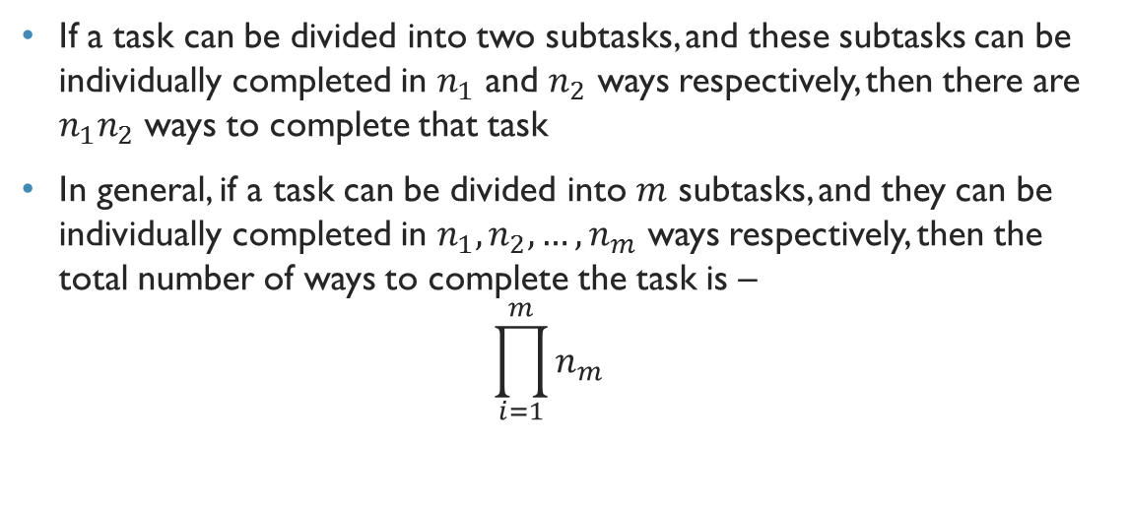
Recap: Product rule
If a task can be divided into two subtasks, and these subtasks can be individually completed in $n_{1}$ and $n_{2}$ ways respectively, then there are $n_{1}n_{2}$ ways to complete that task
In general, if a task can be divided into $m$ subtasks, and they can be individually completed in $n_{1},n_{2},…,n_{m}$ ways respectively, then the total number of ways to complete the task is – $\prod_{i=1}^{m}{n_{m}}$

Slide 4
The sum rule

Slide 5
Let’s travel from Dhaka to Chittagong, again!!
We can travel from Dhaka to Chittagong in bus, train or by air
How many buses are there?
Shohag, Green line, Hanif
How many trains are there?
Mahanagar, Subarna, Sonar Bangla, Turna
How many flights are there?
Novoair, US-Bangla
So how many ways we can travel?

Slide 6

Let’s travel from Dhaka to Chittagong, again!!
Buses: Shohag, Green Line, Hanif $→$ 3
Trains: Mahanagar, Subarna, Sonar Bangla, Turna $→$ 4
Flights: Novoair, US-Bangla $→$ 2
Total = 3 + 4 + 2 = 9

Slide 7
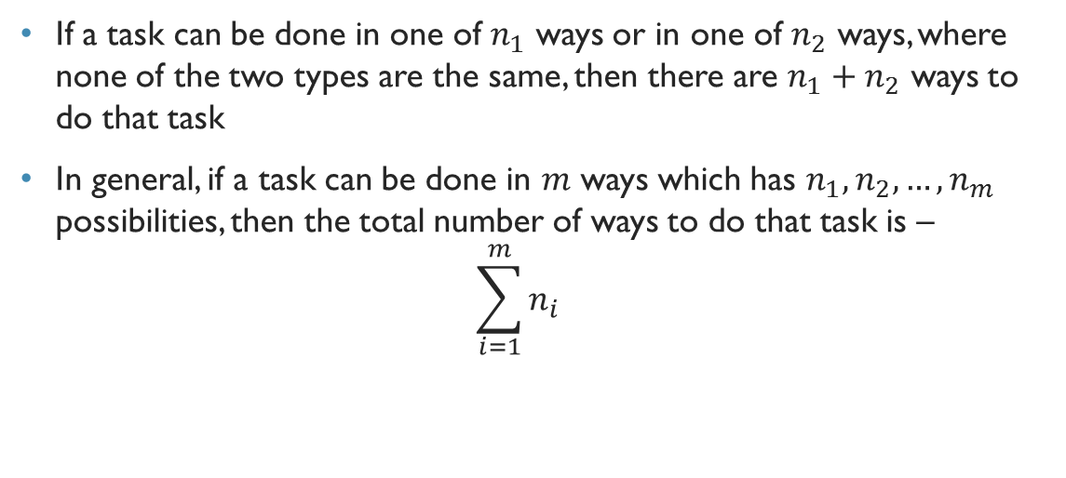
The sum rule
If a task can be done in one of $n_{1}$ ways or in one of $n_{2}$ ways, where none of the two types are the same, then there are $n_{1}+n_{2}$ ways to do that task
In general, if a task can be done in $m$ ways which has $n_{1},n_{2},…,n_{m}$ possibilities, then the total number of ways to do that task is – $\sum_{i=1}^{m}{n_{i}}$

Slide 8
The pigeonhole principle

Slide 9
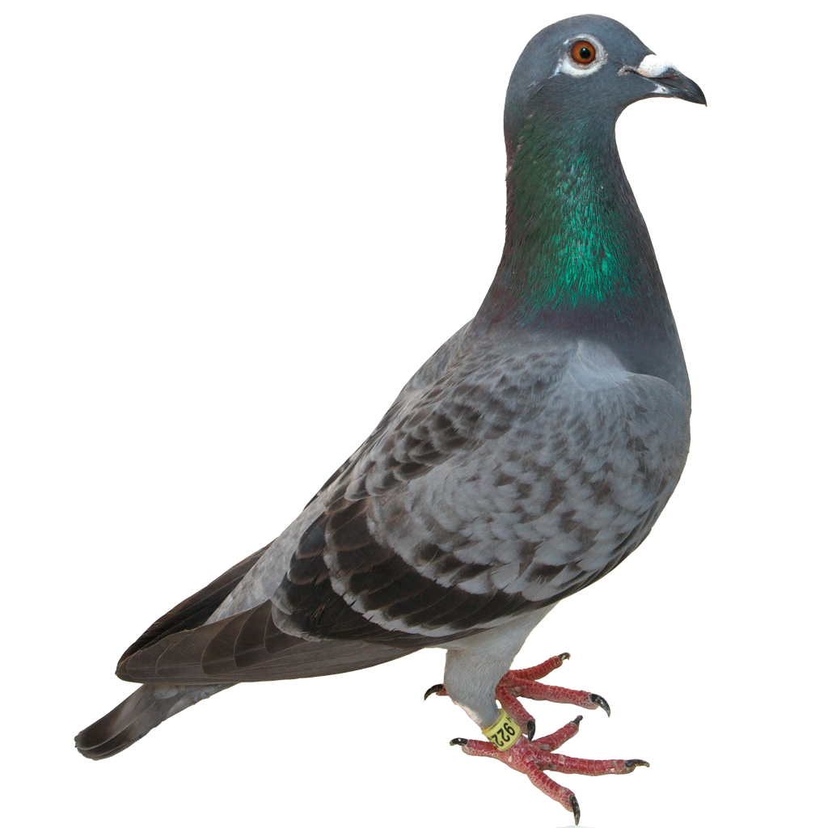
How to place these pigeons?
12 piegonholes
13 pigeons

Slide 10
How to place these pigeons?

Slide 11

The pigeonhole principle
If $k$ is a positive integer, and $k+1$ or more objects are placed into $k$ boxes, then there is at least one box that contains two or more objects

Slide 12

Generalized pigeonhole principle
If $N$ objects are placed into $k$ boxes, then there is at least one box containing at least $\left\lceil \frac{N}{k}\right\rceil$ objects

